Slide 1


IOT Server using Adafruit IO
LÊ TRỌNG NHÂN
trongnhanle@hcmut.edu.vn
trongnhanle85@gmail.com

Slide 2
Content
Create repository in GitHub (reuse from LAB1)
Build an MQTT connection with Adafruit IO
Publish random data to Adafruit IO server
Receive data from Adafruit IO server
Extra works: Publish AI results to Adafruit IO server

Slide 3
Create an Account in Adafruit IO
https://io.adafruit.com/
Create an account for your group
The account can be shared, but your key cannot be shared or public to Github

Slide 4
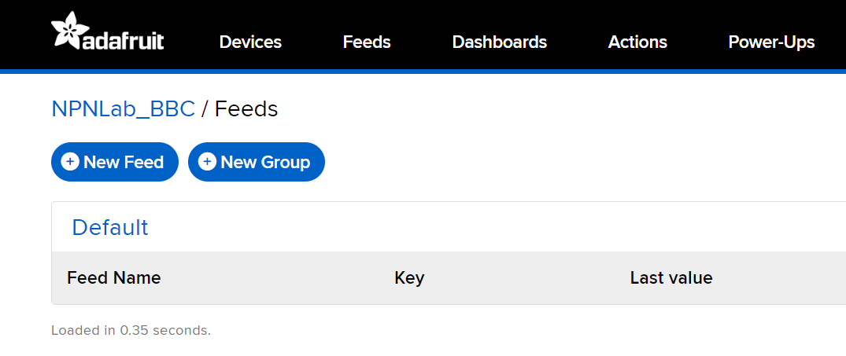
Feeds and Dashboard
Feeds is the backend of the server
Dashboard is the frond end of the server

Slide 5
Step 1: Create feeds in AIO
Feed name should be lower-case and without special character
Create 3 feeds for sensor data:
sensor1, sensor2, sensor3
Create 2 feeds for button:
button1, button2
Create 1 feed for the AI
ai

Slide 6
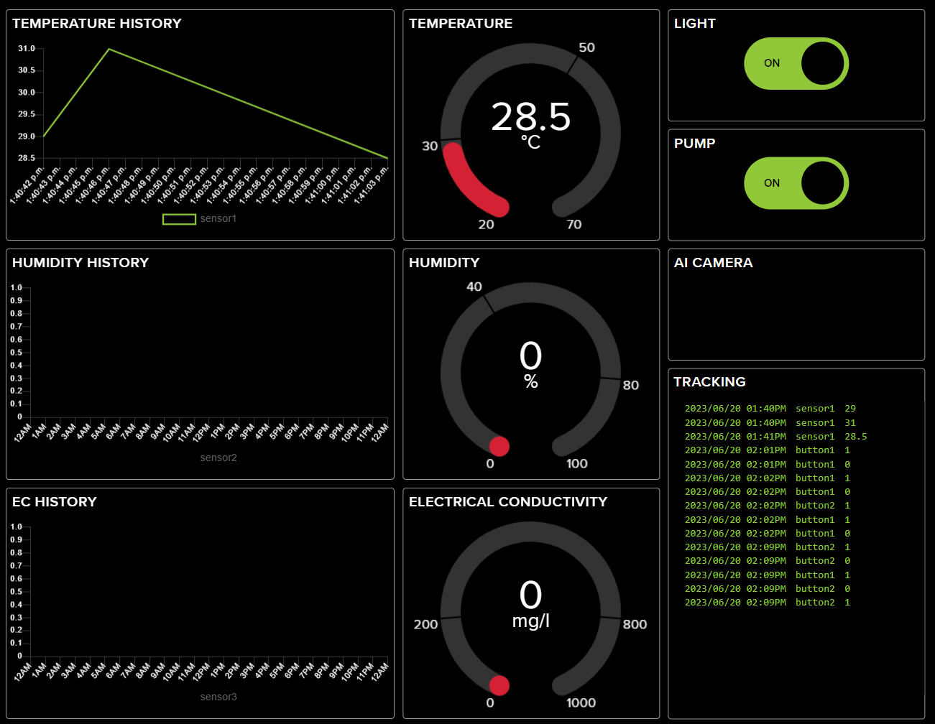
Step 2: Create Dashboard in Adafruit IO

Slide 7
Part 1: MQTT Connection in Python

Slide 8
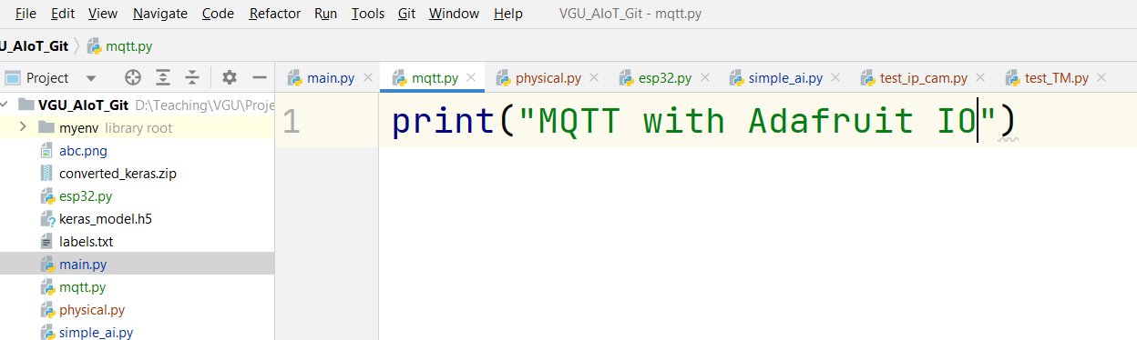
Step 1
Create a new python file:
Named the file link mqtt.py
Run your python file
Student should print to the console a simple string in order to test the Python Editor and Python Interpreter

Slide 9
Step 2
Install the adafruit-io package
pip install adafruit-io
In Pycharm, package can be installed by GUI:
File/Setting/Project
Select your project (VGU_AIoT)
Click on Python Interpreter
Click on the Plus icon and search for the package
Ref link: https://github.com/npnlab-vn/code-manager/blob/IoT_Lab3/IoT_Lab.py

Slide 10
Step 3: Import package and Init values
import sys
from Adafruit_IO import MQTTClient
AIO_FEED_ID = ""
AIO_USERNAME = ""
AIO_KEY = ""

Slide 11
Step 4: Define MQTT Callbacks
def connected(client):
print(“Connected to server!!!")
client.subscribe(AIO_FEED_ID)
def subscribe(client , userdata , mid , granted_qos):
print(“Subscribed successfully...")
def disconnected(client):
print(“Disconnected from server!")
sys.exit (1)
def message(client , feed_id , payload):
print(“Received dataa: " + payload)

Slide 12
Step 5: Initiate the MQTT Client
client = MQTTClient(AIO_USERNAME , AIO_KEY)
client.on_connect = connected
client.on_disconnect = disconnected
client.on_message = message
client.on_subscribe = subscribe
client.connect()
client.loop_background()

Slide 13
Step 6: Run the MQTT service
Change the AIO_FEED_ID to the array
AIO_FEED_ID = [“button1”, “button2”]
Modify the subscribe process in connected function:
def connected(client):
print(“Connected to AIO!!!")
for topic in AIO_FEED_ID:
client.subscribe(topic)

Slide 14
Extra Work: Upload AI Resutl to Adafruit IO

Slide 15
Introduction
The AI result can be published to the Adafruit IO for remote monitoring
When AI is combined with IoT, we form a kind of AIoT application!!!

Slide 16
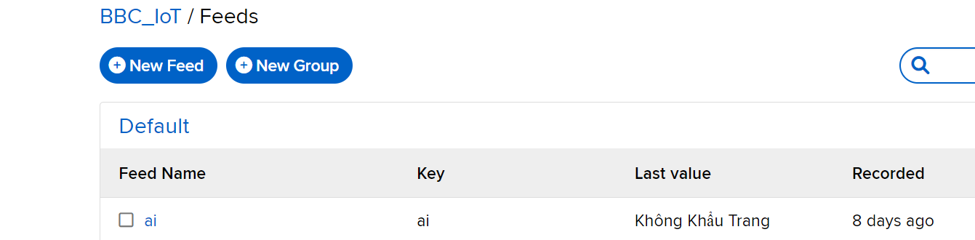
Step 1
Create an account in Adafruit IO
Create a feed on Adafruit IO:
Feed/ New Feed
Provide the name for the Feed, e.g. “ai”

Slide 17
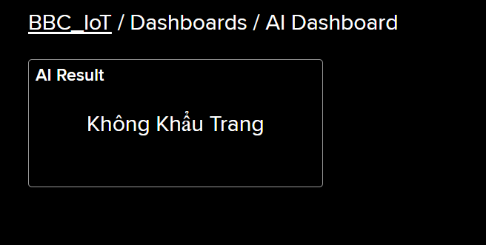
Step 2
Create a simple Dashboard, have a textview to display the last data from feed ai

Slide 18
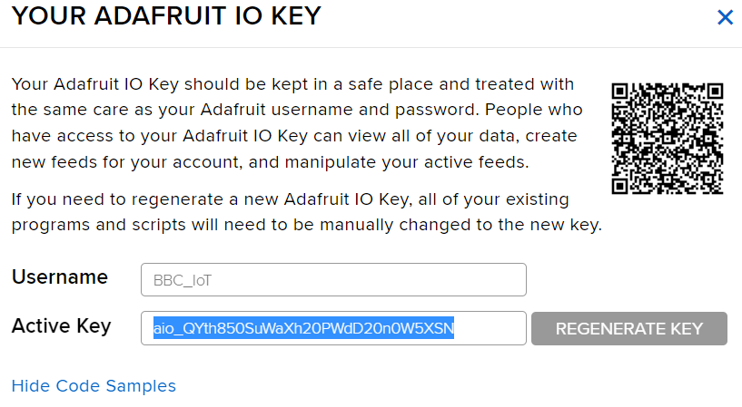
Step 3
Copy your account and your key, which are used for the Python programming

Slide 19
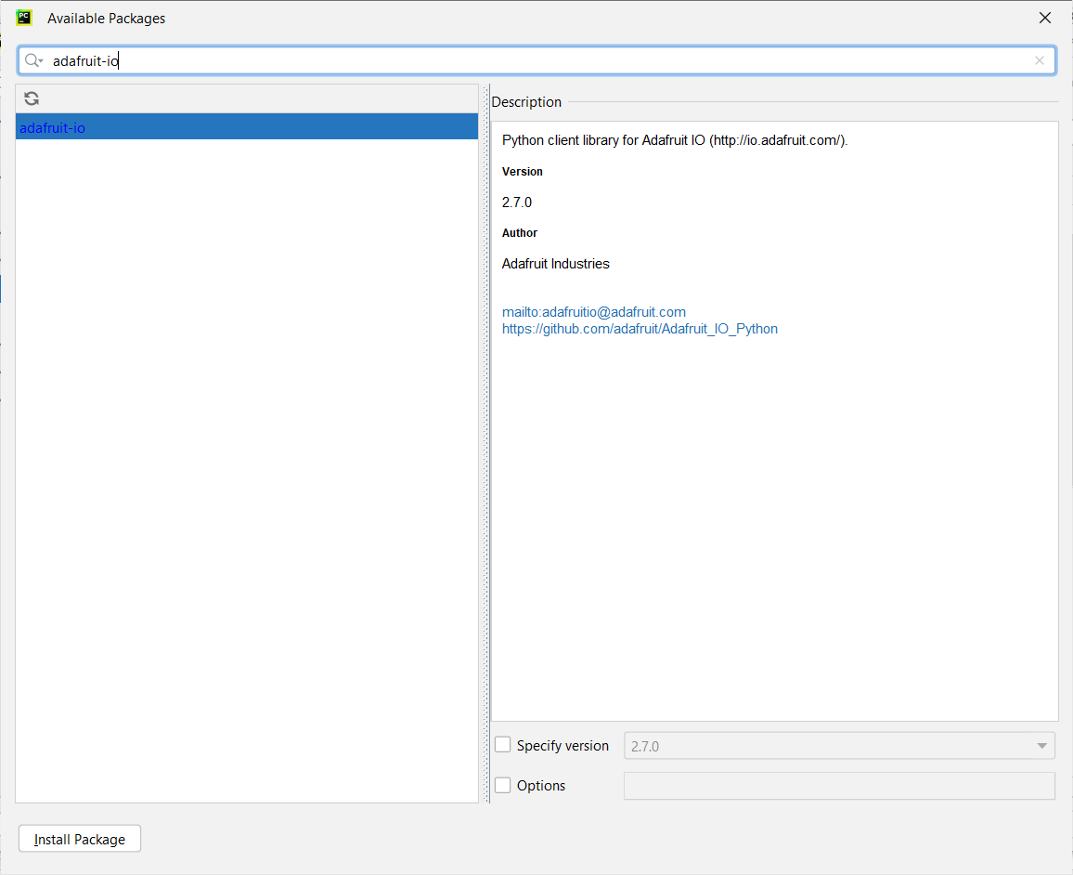
Step 4
Install the adafruit-io library
Import libs:
import sys
from Adafruit_IO import MQTTClient

Slide 20
Step 5
Create an instance of the MQTT Client
Then, use client.publish(“ai”, “your_ai_result”) to the service
client = MQTTClient("your_usr","your_key")
client.connect()
client.loop_background()

Slide 21
Step 6
print("Hello AI") from keras.models import load_model from PIL import Image, ImageOps import numpy as np import cv2 import time from Adafruit_IO import MQTTClient cam = cv2.VideoCapture(0) # Load the model model = load_model('keras_model.h5') def image_capture(): ret,frame = cam.read() cv2.imwrite ("test.png",frame) def image_detector(): # Create the array of the right shape to feed into the keras model # The 'length' or number of images you can put into the array is # determined by the first position in the shape tuple, in this case 1. data = np.ndarray(shape=(1, 224, 224, 3), dtype=np.float32) # Replace this with the path to your image image = Image.open('test.png') #resize the image to a 224x224 with the same strategy as in TM2: #resizing the image to be at least 224x224 and then cropping from the center size = (224, 224) image = ImageOps.fit(image, size, Image.ANTIALIAS) #turn the image into a numpy array image_array = np.asarray(image) # Normalize the image normalized_image_array = (image_array.astype(np.float32) / 127.0) - 1 # Load the image into the array data[0] = normalized_image_array # run the inference prediction = model.predict(data) #get the 1D array output = prediction[0] #assign default value for max confidence max_index = 0 max_confidence = output[0] #find the maximum confidence and its index for i in range(1, len(output)): if max_confidence < output[i]: max_confidence = output[i] max_index = i print(max_index, max_confidence) file = open("labels.txt",encoding="utf8") data = file.read().split("\n") print("AI Result: ", data[max_index]) client.publish("ai", data[max_index]) client = MQTTClient("BBC_IoT","aio_QYth850SuWaXh20PWdD20n0W5XSN") client.connect() client.loop_background() while True: time.sleep(5) image_capture() image_detector()
Finalize the whole program

